Slide 1

Precipitation and Rising air Temperatures in Connecticut
Background – climate change has been said to increase the frequency and intensity of extreme weather events
My goal – see if this holds true in Connecticut for precipitation
Question 1: Have air temperatures increased?
Question 2: Are days with very high or low levels of precipitation becoming more common?
Question 3: Is there a link between these two phenomenon?
Notes:
Thank you for giving me the opportunity to interview today.
I would like to discuss and demo my final project for my data science class, which explored the link between rising air temperatures and extreme precipitation relative to climate change

Slide 2
Data + Terminology
8 stations from 8 different counties in Connecticut
Daily records of high, low, precipitation, along with location data
Extreme precipitation events = day where precipitation total > 2 standard deviations from mean for that year
Measuring change in air temperature by yearly average high and low temperatures

Slide 3
Q1: Have air temperatures increased in Connecticut since 1920?

Slide 4
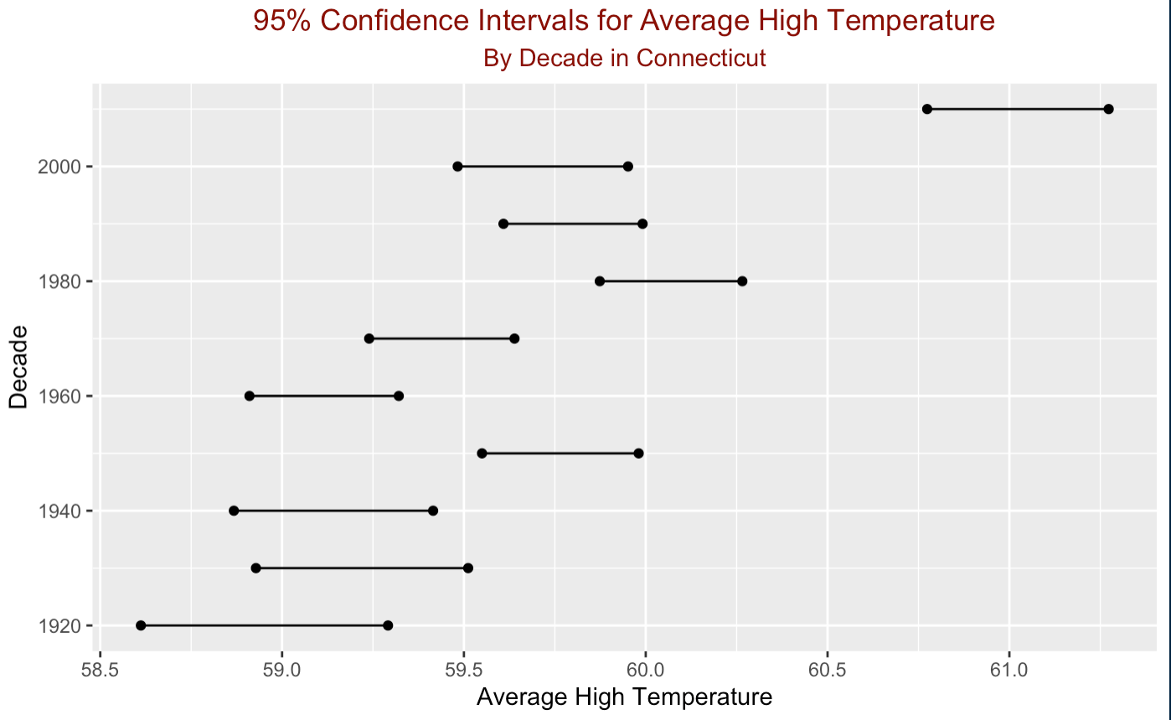
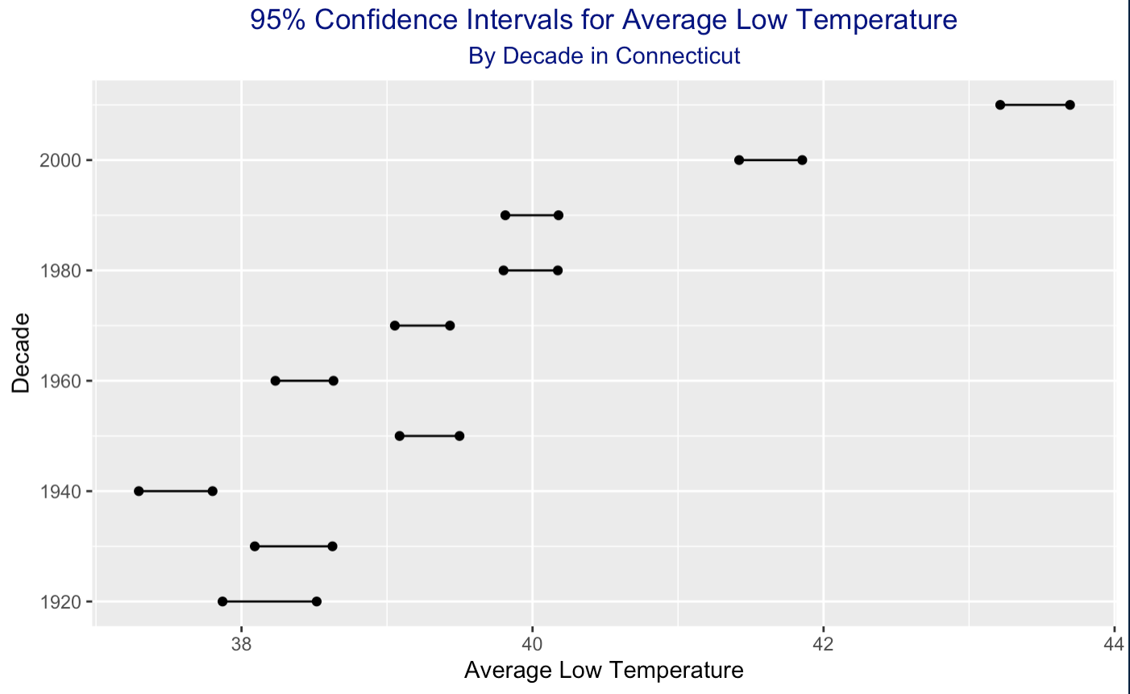
Confidence Interval for Average High + Low
Notes:
Given my limited selection of data, only having 1 station per county, I employed a resampling method known as bootstrapping to synthetically inflate the number of observations
The process went as follows:
I resampled the observations for each decade from my original dataset 1000 times with replacement, so that the samples included the real data but were not all identical
I then computed the mean of each of these simulated datasets
I took the 25th largest and 975th largest means, which corresponded to the 97.5th and 2.5th percentile, respectively
These became the bounds for my 95% confidence interval, since 95% of the simulated means fell between these 2 points
I repeated this process for each decade and plotted the intervals as you see here
I did this for average high and low temperatures
Given that the confidence intervals for the 2010s do not overlap with those of the earlier decades, I concluded that high and low temperatures have increased in Connecticut on average since 1920

Slide 5
Q2: Are days with very high or low levels of precipitation becoming more common?

Slide 6
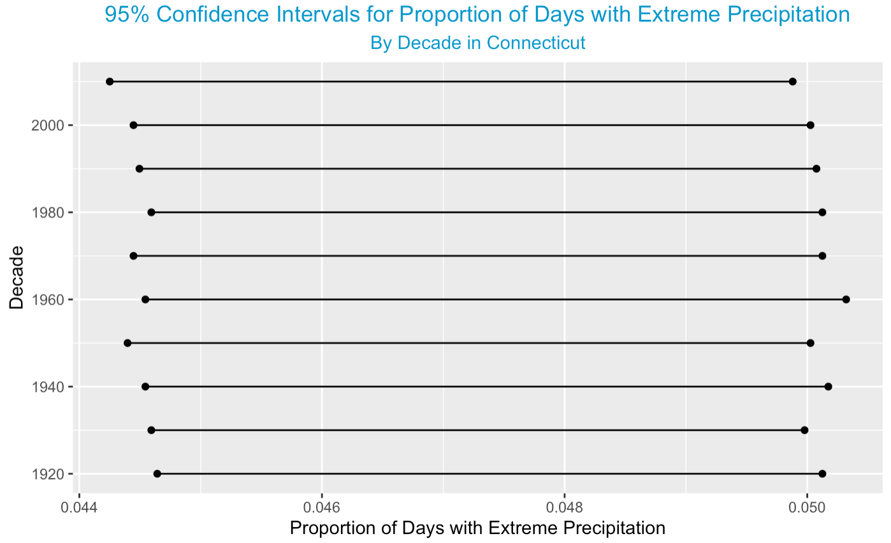
Confidence Interval: extreme Precipitation
Notes:
I followed the same boostrapping approach to create confidence intervals for the proportion of days in a year with extreme precipation
These results showed overwhelming parity amongst all the decades, so I could not conclude that extreme precipitation was becoming any more common over time

